Slide 1
Corporate presentation 2025
05.03.2025

Slide 2
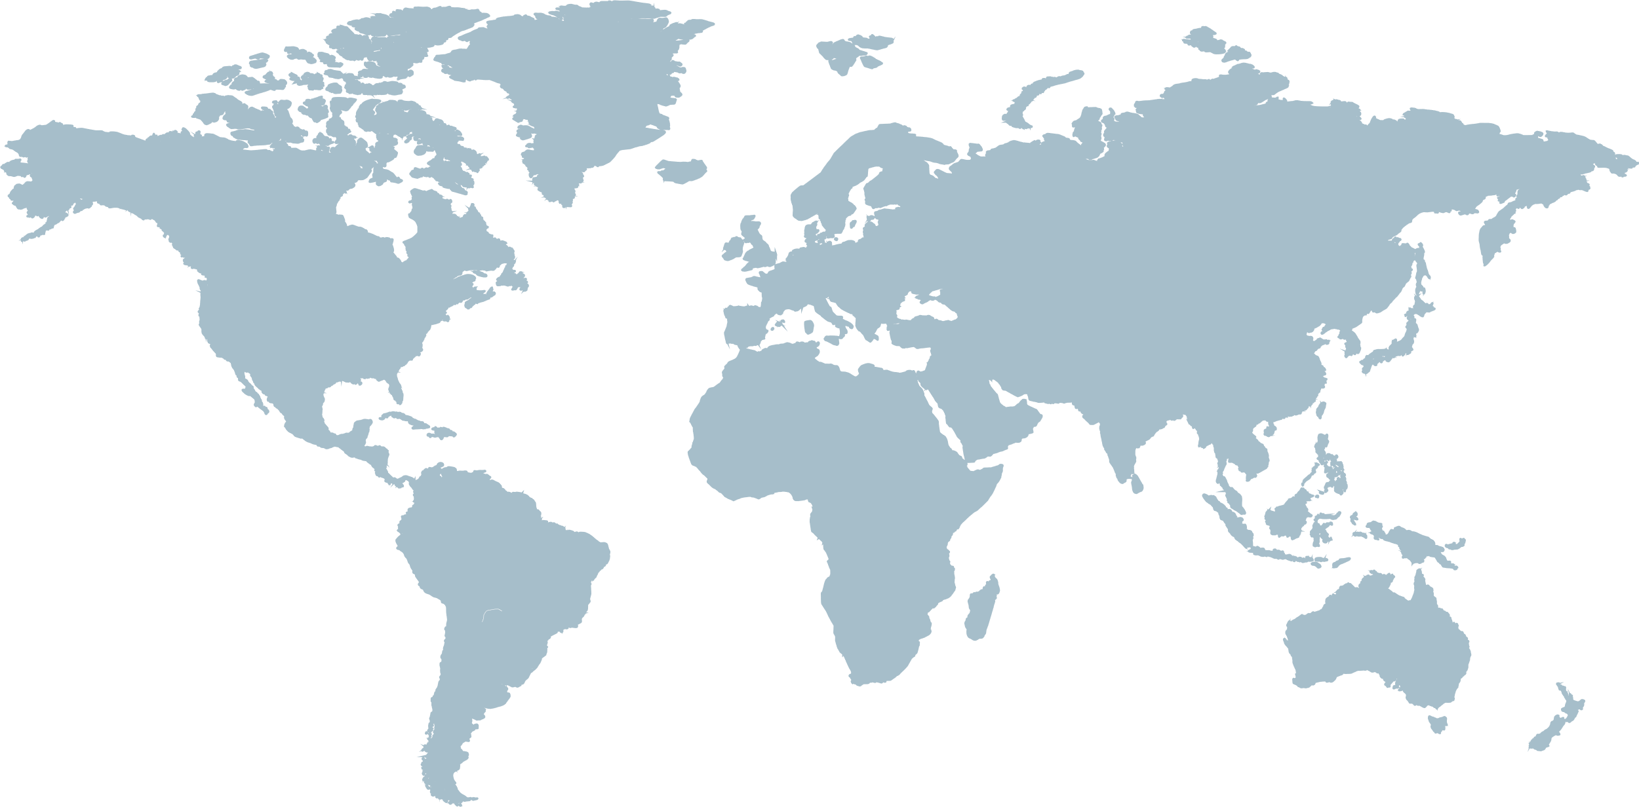
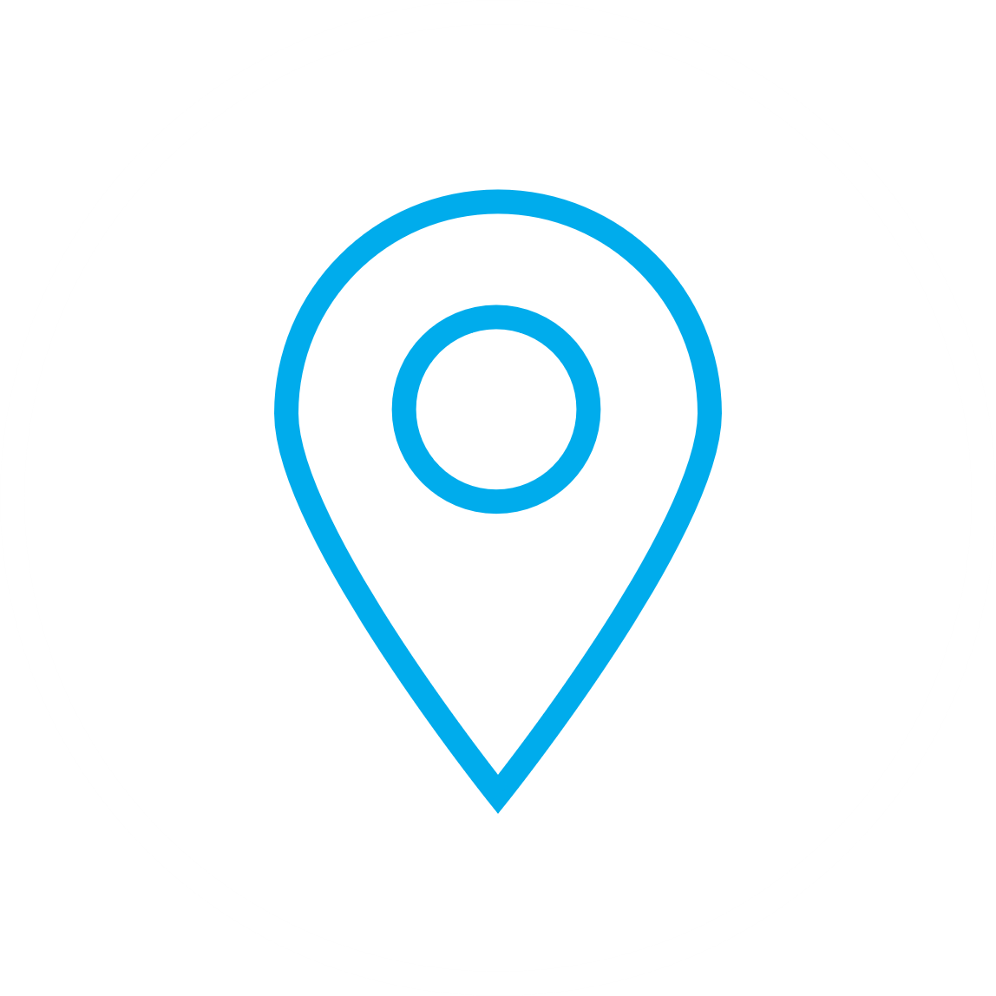
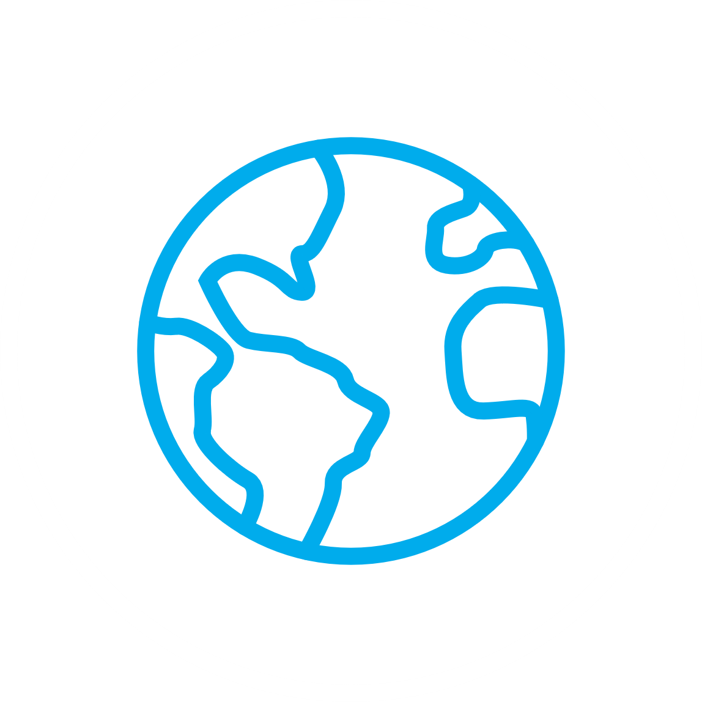
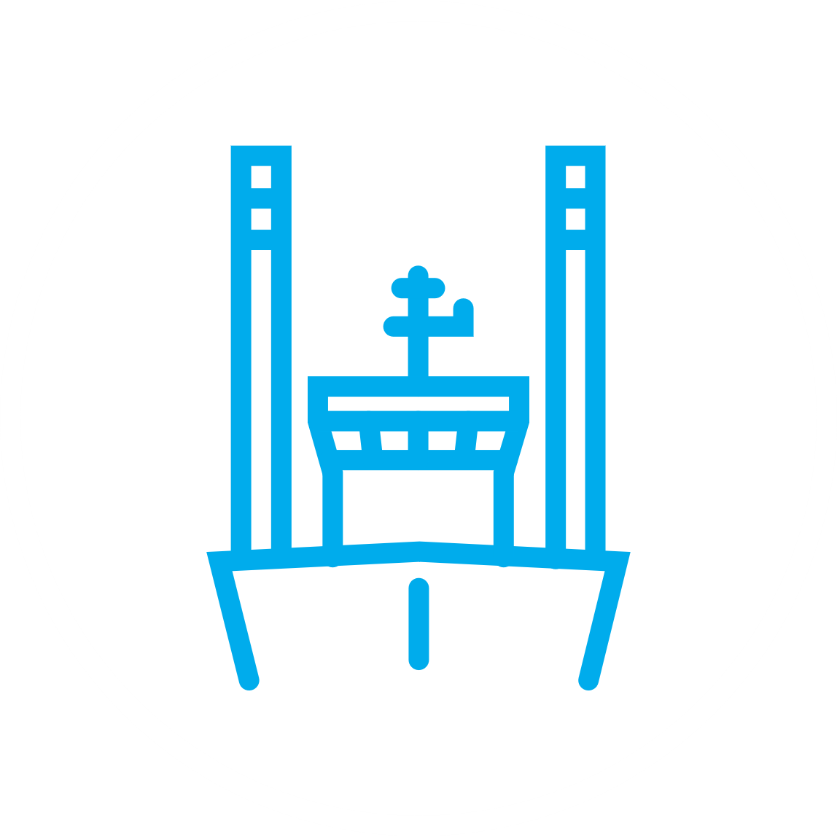
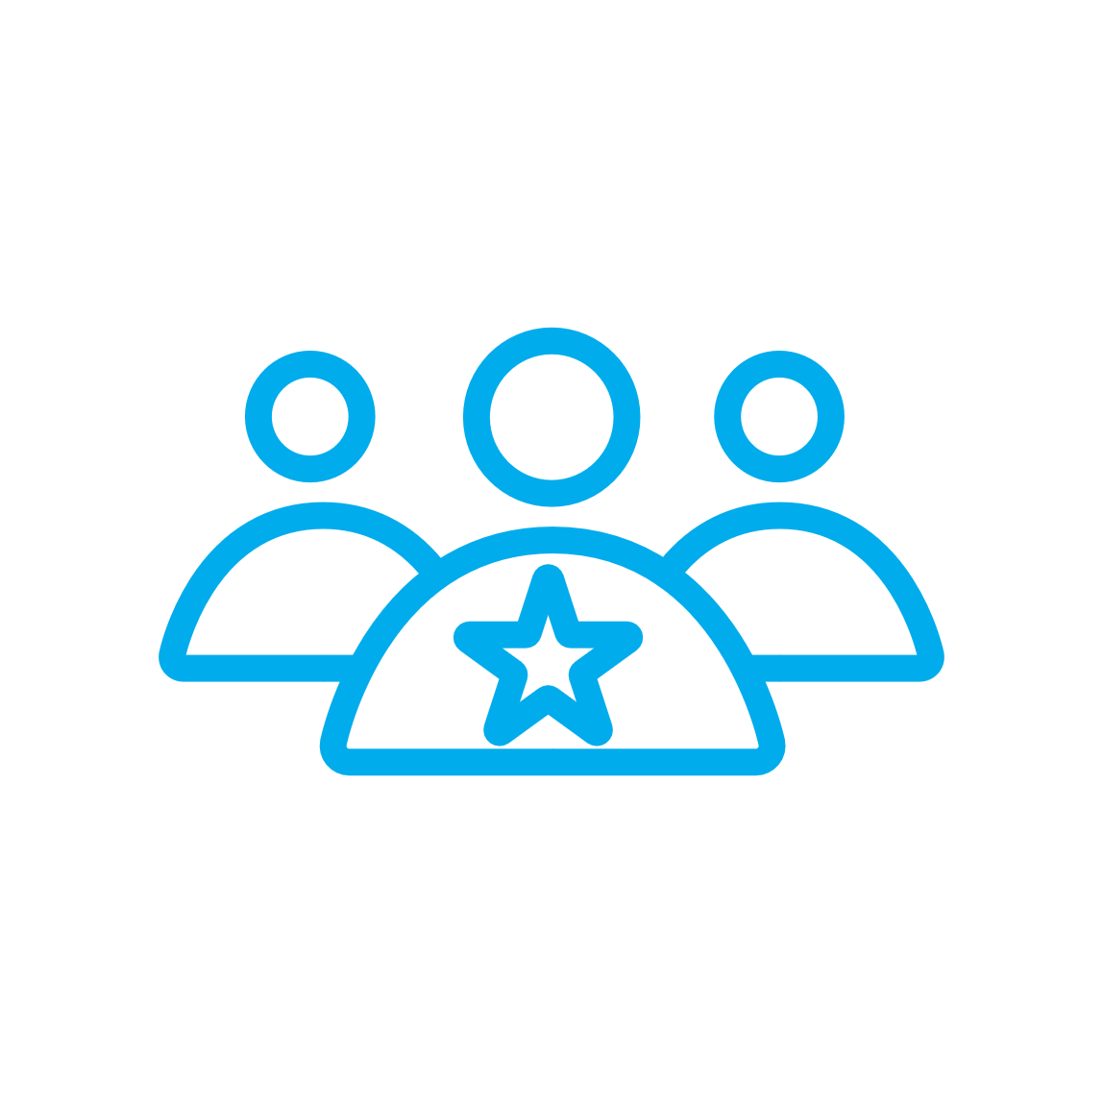
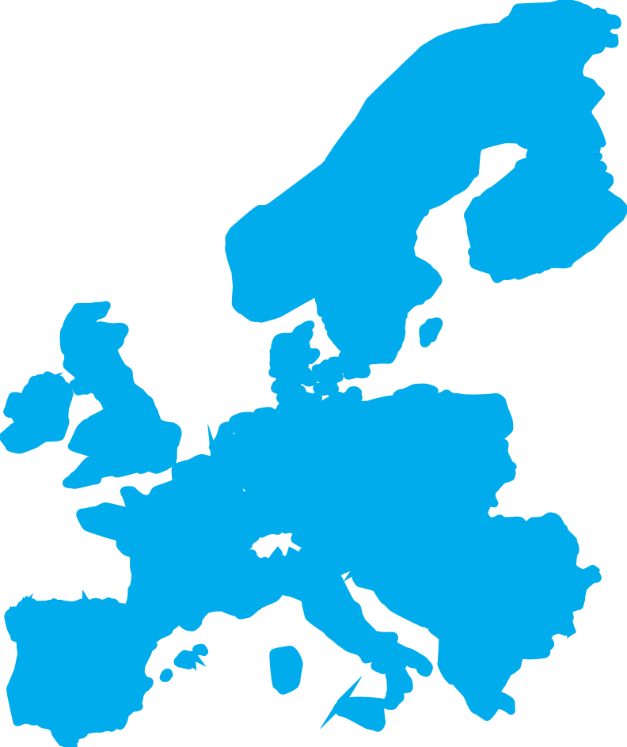
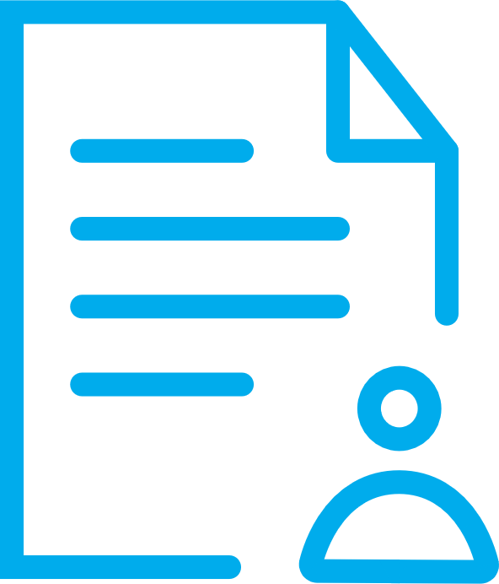
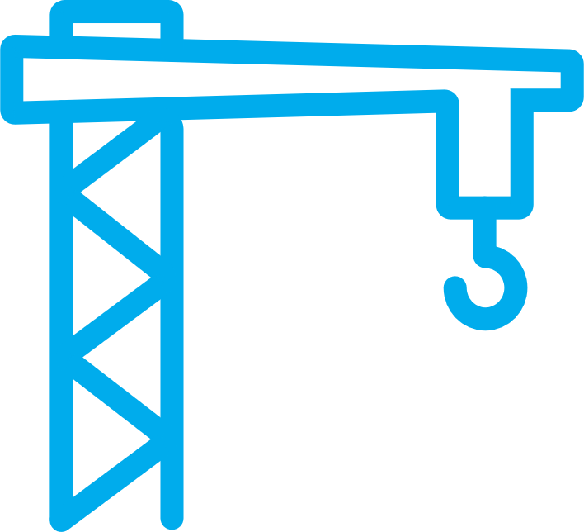
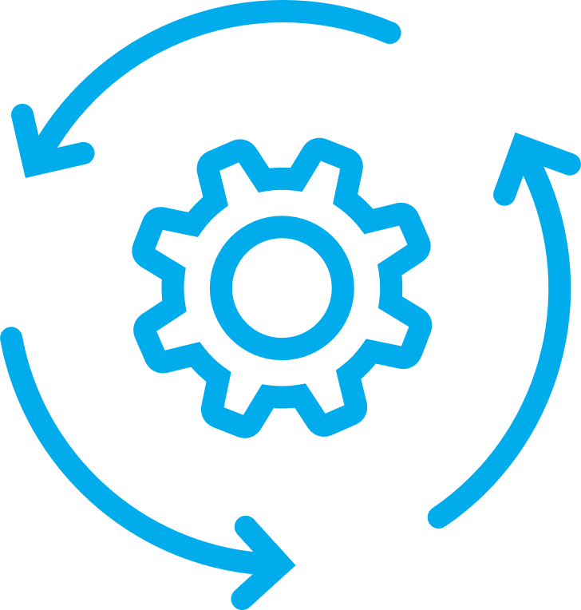
Fred. Olsen Windcarrier at a glance
t
t
60+
1
t
First mover
5
Founded in 2008
>250 employees
First mover
Global strategy – proven track record in all core markets
World leading installation vessel fleet
Offices
Projects executed
Global market share¹
WTGs installed
Our main deliverables
>1,100
Approx. 20%
MW installed
>7,850
Project management
Transport & installation
Operations &
maintenance
Notes:
Calculated as a percentage of turbines installed globally (excl. China) since FOWIC installed its first turbine in 2013
MOU in place with Shimizu Corporation in Japan

Slide 3
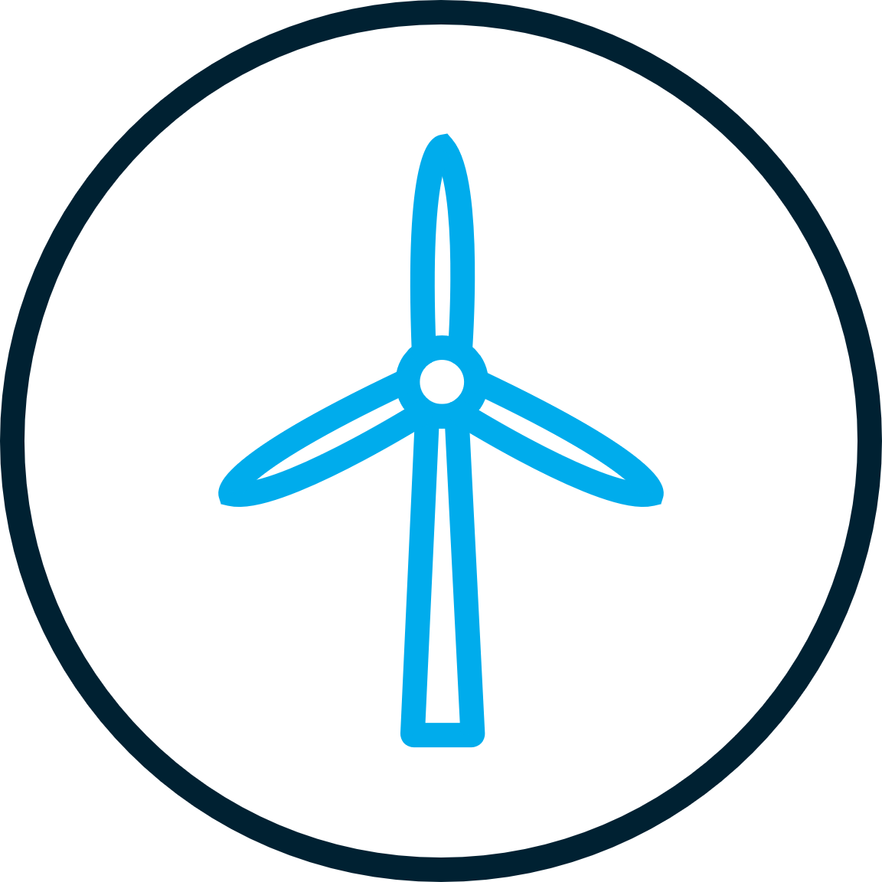

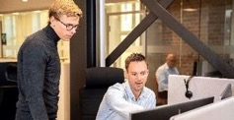
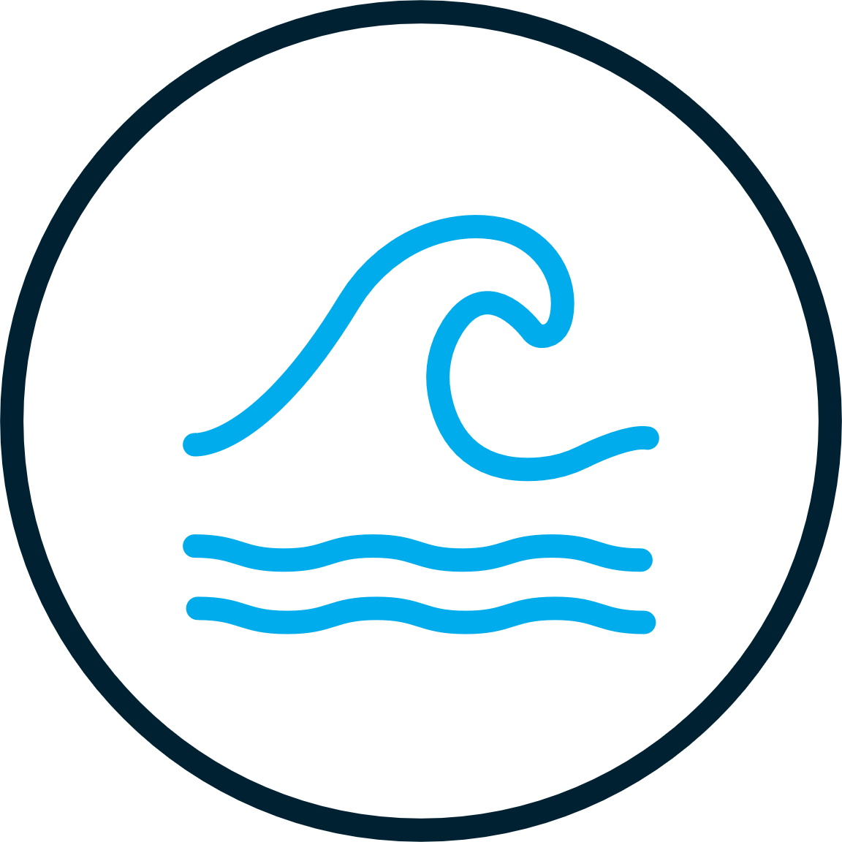
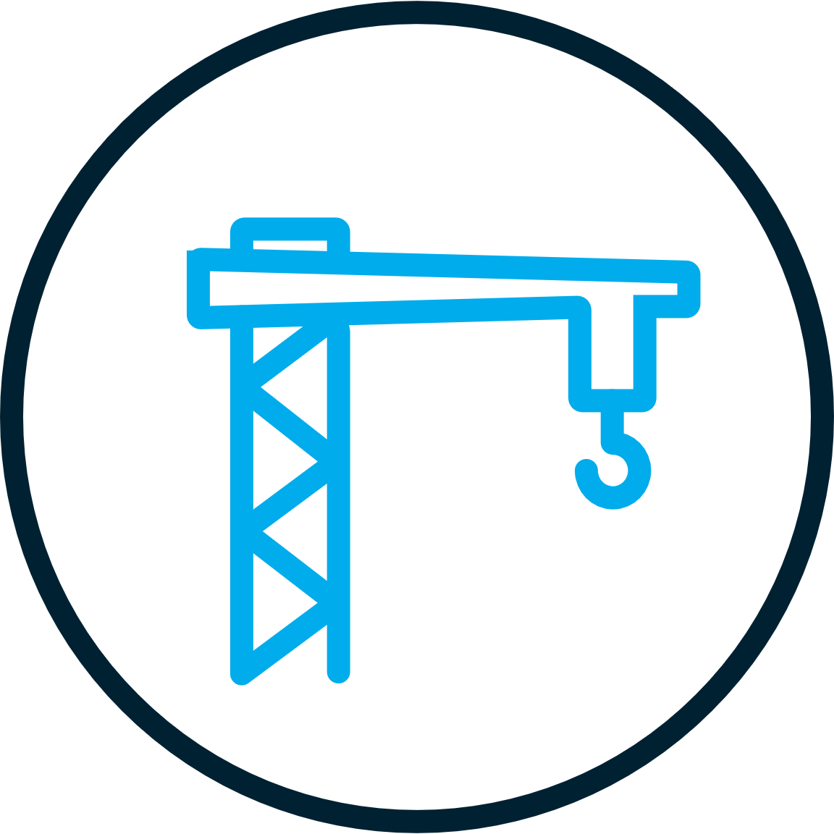
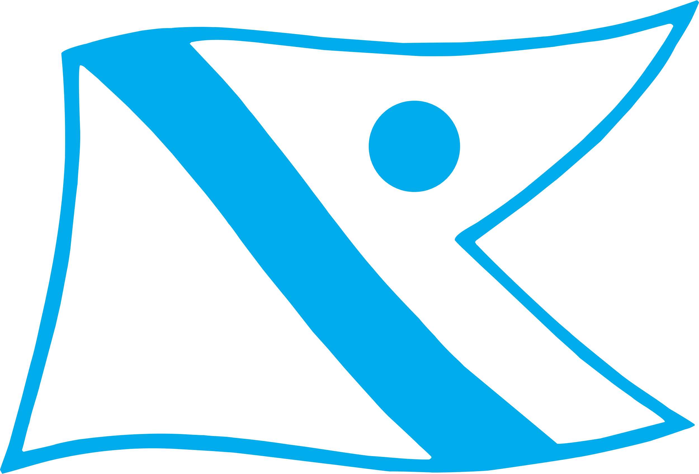
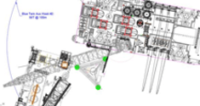
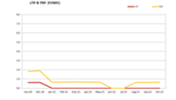
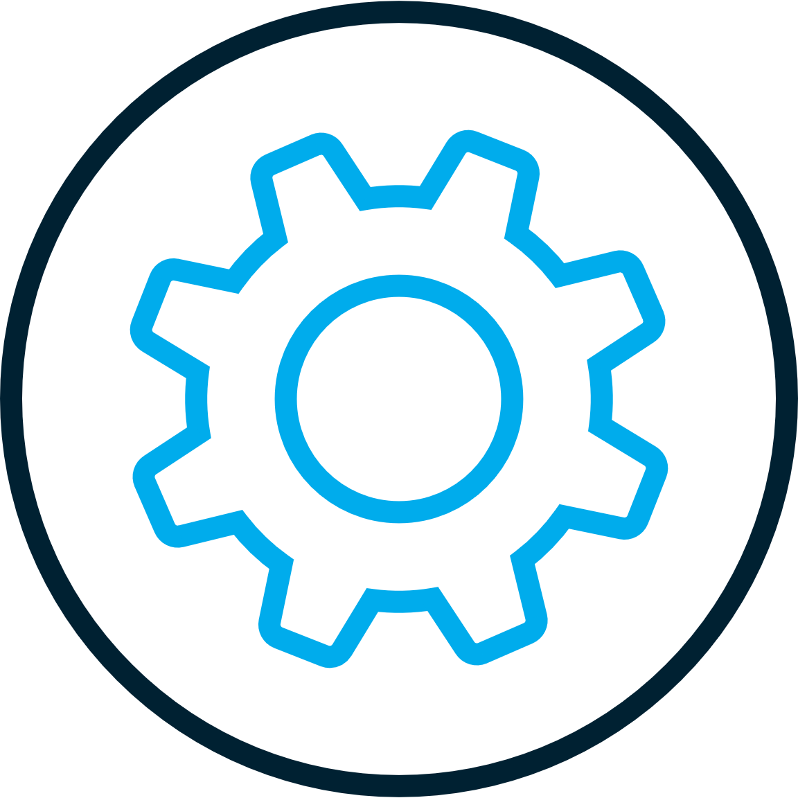
People, systems and track record
Repetitive and time critical operations often under harsh
and everchanging working conditions
Need to do it right, every time, under all conditions
– high cost in case of failure
Repetitive and time critical operations often under harsh and everchanging working conditions
Solid governing systems, processes
& procedure
Unparalleled team capabilities, people & know how and track record
Repetitive: 100 turbines equals 1000 lift per project
Adaptable and often harsh offshore conditions:
Wind, waves, currents and poor visibility
Last on-site Seabed geotechnical, uxo´s, boulders, cables and as-built from others
Leading and flexible project planning, engineering and execution
Strong safety track record through high standards and strict training
Need for reliant operations with timely completion
Turbine installation is “final” element before wind park cash flow

Slide 4





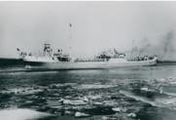



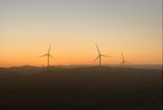




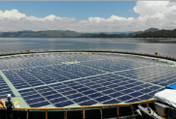


176 years – entering new business markets
1848
1897
1912
1914
1914
1929
1935
1965
1967
Originated
Bayard
Bessheim
Akers mek Verkested
Brazil
Borgny II
Aviation
Petroleum
Offshore drilling
The family shipping business is founded
Transition from sail
to steam ships
Early passenger services
First motorship
in fleet
First motor tanker
Enters commercial aviation
Early offshore stake in the North Sea
Enters offshore drilling
Enters shipbuilding
1992
1999
2003
2009
2012/13
2021
2021
2022
Onshore wind
Green House
Wind measurement systems
Service of wind turbines
Jack-up vessels
Floating solar
Offshore wind
Technology & innovation
Fred. Olsen Renewables first wind farm in Scotland
Enters renewables consultancy with Natural Power
Fred. Olsen Windcarrier takes delivery of Bold and Brave Tern
Fred. Olsen Renewables enters floating solar power
Fred. Olsen Seawind formed to invest in offshore wind development
ZX Lidars is founded
Aquires a major stake in Global Wind Service
Fred. Olsen 1848 established

Slide 5


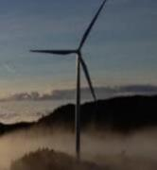
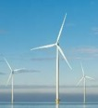
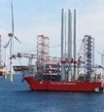
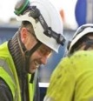
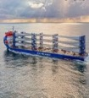
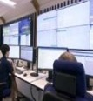
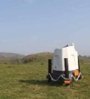
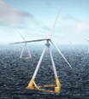




Fred. Olsen-related companies in renewable energy
Renewables
Services
Technology & innovation
Capital
Hvitsten Asset Manager
Onshore wind and other renewables developer and owner
Pure-play offshore wind developer and owner
Turbine installation services
On- and offshore Installation, Service and expertise
Solution for wind transportation
Independent consultant
and service providers
Wind measurement systems
Technology & innovation
Software as a Service
Financial partnerships
Managing further investment opportunities
805 MW
in operation
4GW pipeline
2+GW gross pipeline
20% of all offshore wind turbines globally
2000+
Projects delivered across 40 geographies
2,350
Clients served
across 60 geographies
3,500
projects advised on globally across 13 offices
10000+
Lidar deployments onshore, offshore and on turbines
Floating foundation, Mobile Port and other floating solutions
7GW+
on our systems. Making asset management safer and easier
1,000 EURm equity through
Fund management and financial JVs
Investments made within renewable energy related companies
+2,600 employees with activities in more than 40 countries

Slide 6
The Fred. Olsen offshore companies
Global Wind Service
Fred. Olsen 1848
The company with the man-power to comprehensively service both onshore and offshore wind installation and maintenance projects worldwide.
The technology and innovation incubator that explores and matures new technologies and solutions within the offshore wind industry.
Broad offshore expertise and know how
Fred. Olsen Windcarrier
Fred. Olsen Seawind
The transport, installation, and service specialist that installs powerful wind turbines at some of the world’s largest offshore wind farms.
The first pure-play offshore wind developer in the Fred. Olsen group.

Slide 7
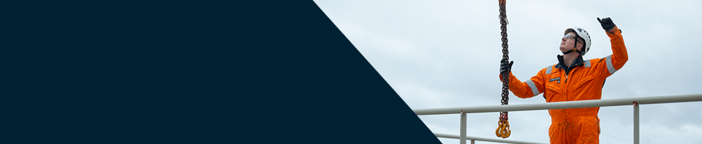

How we collaborate
Trustful partnerships
Fred. Olsen Windcarrier has a proven track record, experienced and skilled people, and highly capable installation vessels. But what we offer, more than anything is our trust and certainty that you can deliver on your projects.
Safety-oriented solutions
Transparent lines of communication
One of the main reasons our customers choose to collaborate with us is our honest and straightforward relationship and our transparent lines of communication.
We have transported, installed, and maintained more than 1000 wind turbines at some of the world’s largest offshore wind farms. And we never compromise on safety.
*99,2
**1,3
+65
Up time
LTIF
Projects
Get to know us even better
Notes:
* 2023 number
** 2024 number

Slide 8
How we differentiate makes a difference for you
People
We take pride in fostering a safe and supportive work environment for people working with us – one that retains talent and ensures reliable
operations for our clients.
Legacy
We are pioneers within the industry, always operating first in core regions of the world. Our clients rely on our compelling track record and the experienced people behind it.
Core business
Installing offshore turbines is our specialty.
This dedicated focus on one of the most critical parts of a project enables us to provide services that are not only efficient and cost-effective but also timely, flexible, and safe.

Slide 9

Support at every stage of the wind farm lifecycle
Project
management
Mobilisation & Demobilisation
Transport & Installation
Operations & Maintenance
Delivering precise marine operations
Efficient & reliable preparation of vessel
Hardware and know how you can rely on
Complete O&M solutions

Slide 10
Our hands-on approach to complex offshore engineering
Experts in operational efficiency
Because our engineers spend time onboard our installation vessels and understand how project planning ultimately affects the efficiency of operations, sim-ops, and safety.
Engineering you can trust
With 10 years of experience our engineers have worked with all wind turbine models and hold experience from marine, structural and geotechnical engineering to sea fastening, and power supply.
Experienced innovators
Our engineers constantly think of new and innovative solutions, and their close collaboration with our vessel crews results to operational efficiency and high-quality solutions that help you realize your projects.

Slide 11
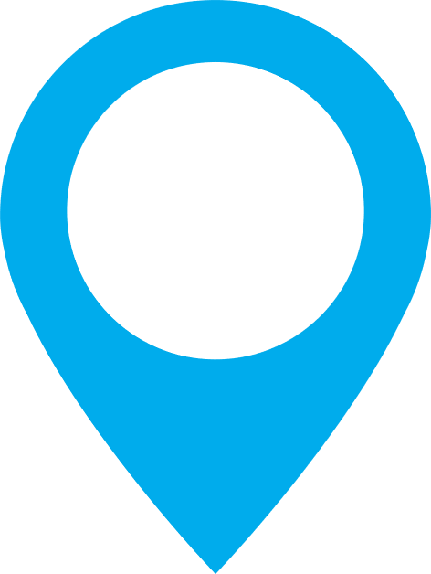
We operate globally
We have extensive offshore experience across the US, Europe, and APAC.
Each global region presents different conditions and unique challenges. But because of the valuable experience that our engineers and marine crews have gained over the years from all three regions, and because our fleet is designed to handle any demand, you can trust us with your most complex projects.
We are always ready to embrace new challenges and assist your global ventures.

Slide 12
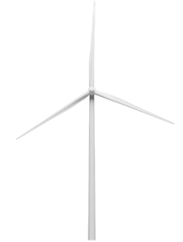
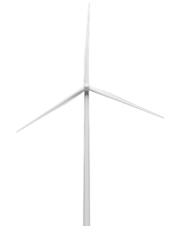
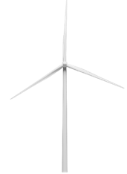
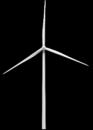

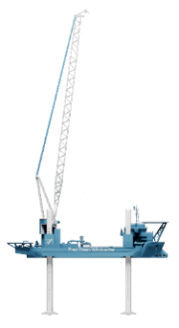
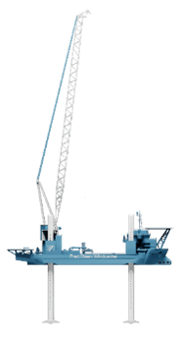
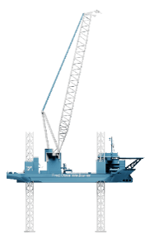
A diverse fleet to handle all turbine sizes for today and tomorrow
Diameter [m]: 250
Diameter [m]: 220
Diameter [m]: 164
Diameter [m]: 151
Diameter [m]: 90
2010
3 MW
2013
5 MW
2013
8 MW
2023
12 MW
+2025
15-20 MW
Bold Tern & Brave Tern
Blue Tern
12

Slide 13
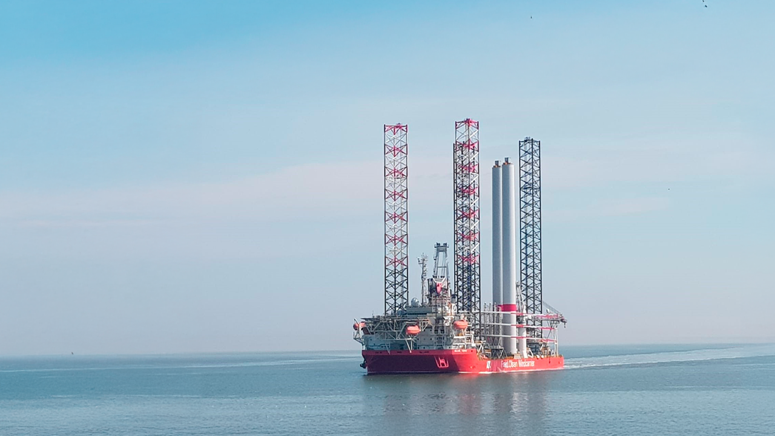


Blue Tern
Ready for heavy O&M work and foundation installation support
5.5 - 65m
800t
8,750t
Of operation water depth range
Main crane
Max variable load

Slide 14
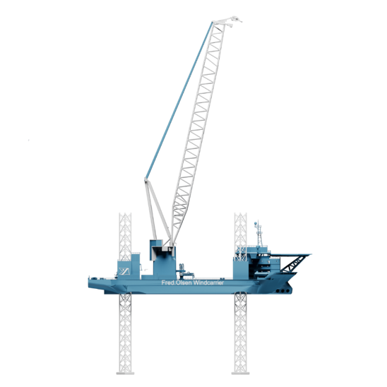
Blue Tern specs
Main Crane:
Liebherr BOS 45000, 3 blocks,
Main hook: 800t 35m radius/200
Accommodation:
Total complement: 150
Deck Cranes:
1 x Liebherr BOS 4200-50, 50t,
42m port side mid ship
1 x Sormec Telescopic crane
10t @ 10m – 2.5 t @ 30m
Cargo capacity:
Max variable load [t]: 8,750
Deck area [m²]: 3.750
Legs:
Number & type: 4 x triangular open truss
Diameter [m]: 11.89
Length [m]: 106
Draft:
Min draft (light) [m]: 5.20
Draft at max variable payload [m]: 5.8
Jacking system:
Type: Electric rack & pinion
Effective jacking capacity per leg [t]: 6120
(340t/pinion)
Hull breadth mid [m]: 50
Max leg length below baseline [m]: 88
Hull length [m]: 158

Slide 15
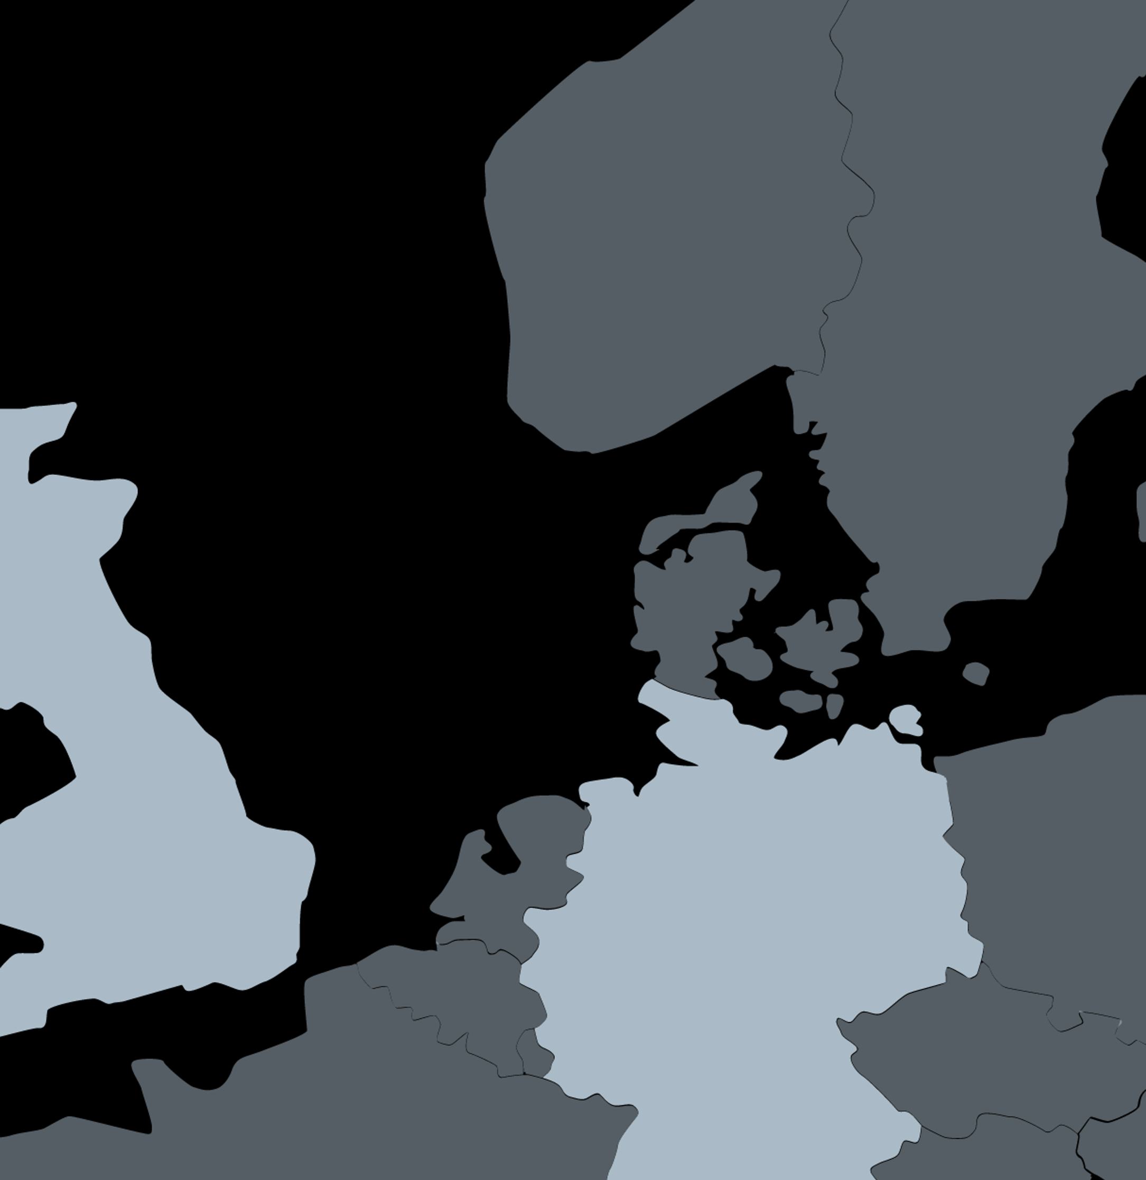
Blue Tern track record
No. | Site | Client | Turbine model | Year
28 | Baltic Eagle | Vestas | Vestas V174-9.5 MW | 2024
27 | Neart na Gaoithe | EDF | SG 8.0MW 167 | 2023
20 | Neart na Gaoithe | EDF | SG 8.0MW 167 | 2022
19 | Kaskasi | RWE | SG 8.0MW 167 | 2022
13 | Moray East | Vestas | V164-9.5MW | 2021
12 | Trianel Windpark Borkum II | Trianel Windkraftwerk Borkum II | Senvion 6.2M 152 | 2020
11 | Albatros | SGRE | SG 7.0154 | 2019
10 | Hohe See | SGRE | SG 7.0154 | 2019
6 | Merkur | Deme | GE Haliade 6.0MW 150 | 2018
Europe
27
20
13
6
11
19
10
28
12

Slide 16
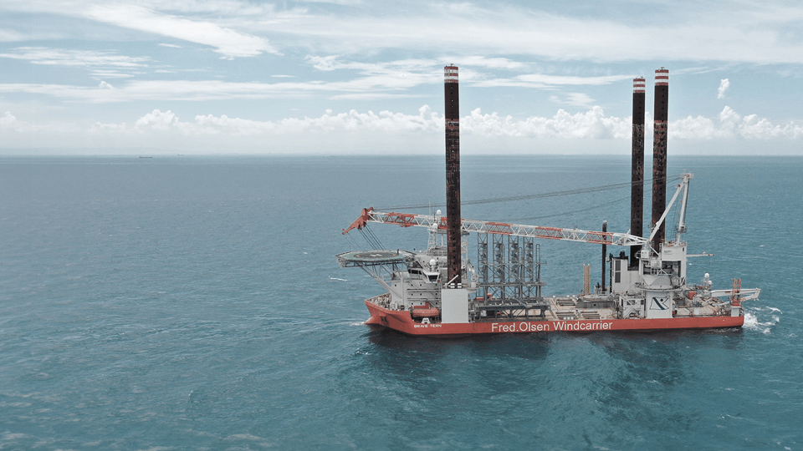
Brave Tern
Ready to service any turbine on the market
5.5 - 60m
1,600t
9,000t
Of operation water depth range
Main crane
Max variable load

Slide 17
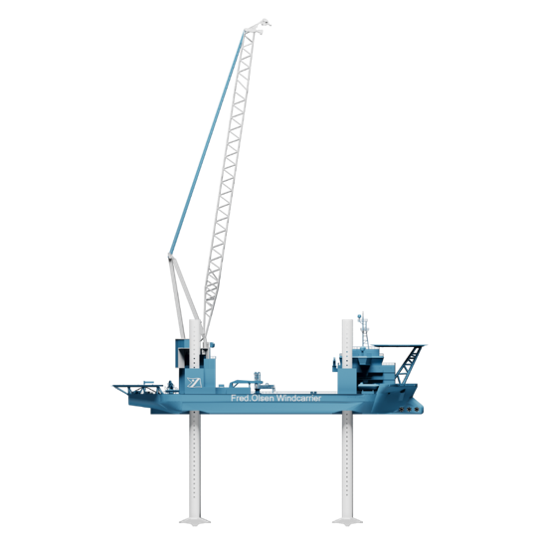
Brave Tern specs
Main Crane:
Type and location: Huisman LEC 65500 around aft port leg Main hook max lifting height: 157.5m above deck
Aux. hook: 450t at 166.5m above deck
Accommodation:
104 people in 68 cabins
Cargo capacity:
Max variable load [t]: 9,000
Deck area [m²]: 3,600
Deck Cranes:
1 x Liebherr BOS 4200-50, 50t,
42m port side mid ship
1 x Sormec Telescopic crane
10t @ 10m – 2.5 t @ 30m
Draft:
Draft at max variable payload:
5.8m at elevated 22,700t
(+0.8 to spud can tip)
Jacking system:
MSC continuous hydraulic double-acting system
Effective jacking capacity per leg [t]: 5,830
All year survival water depth range [m]: 7.5-55
Hull breadth mid [m]: 45
Max leg length below baseline [m]: 70.5
Hull length [m]: 132

Slide 18
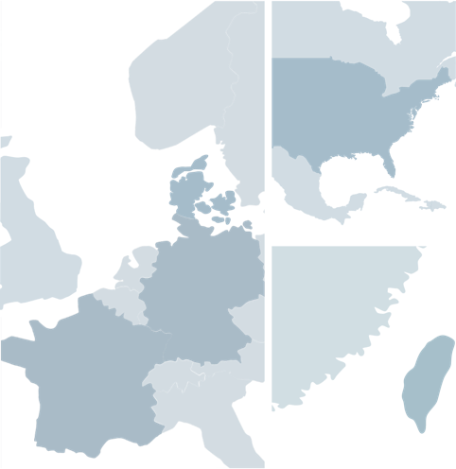
Brave Tern track record
No. | Site | Client | Turbine model | Year
23 | St. Brieuc | SGRE | SG 8.0MW 167 | 2023
22 | Formosa 2 | SGRE | SG 8.0MW 167 | 2022
21 | Yunlin | SGRE | SG 8.0MW 167 | 2022
18 | Yunlin OWF | SGRE | SG 8.0MW 167 | 2021-2022
11 | Albatros | SGRE | SG 7.0MW 154 | 2019
10 | Hohe See | SGRE | SG 7.0MW 154 | 2019
9 | Horns Reef 3 | MHI Vestas | V164-8.0MW | 2018
7 | Wikinger | Adwen | Adwen M5000 135 | 2017
4 | Block Island | Deepwater Wind | GE Haliade 6.0MW 150 | 2016
3 | Global Tech 1 | Areva | Areva 5.0MW 116 | 2014
Europe
US
4
9
3
11
7
10
APAC
23
18
21
22

Slide 19
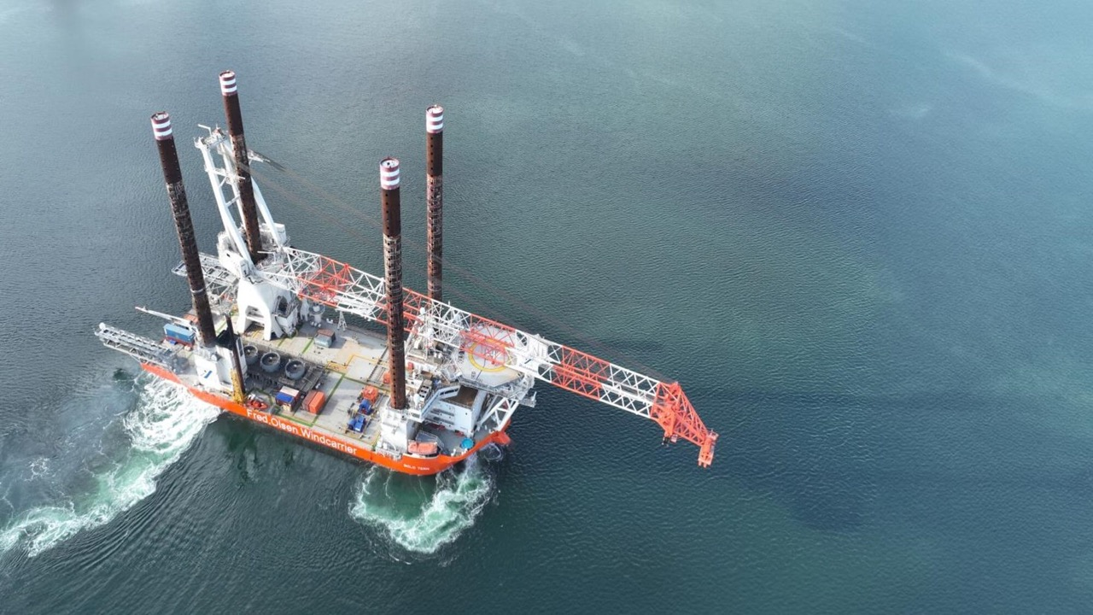
Bold Tern
A unique 1,600t crane
5.5 - 60m
1,600t
9,000t
Of operation water depth range
Main crane
Max variable load

Slide 20
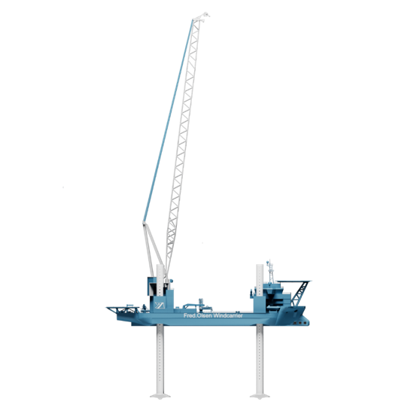
Bold Tern specs
Main Crane:
Huisman LEC 65500 around aft port leg
Capacity: 1,600t at 31m outreach at 157.5 above deck
Aux. Hook: 400t at 166,5m above deck
Accommodation:
80 persons in 68 cabins
Cargo capacity:
Max variable load [t]: 9,000
Deck area [m²]: 3,600
Deck Cranes:
2 cranes of type 20t SWL, 27m max radius. Certified for man-riding
1 Palfinger hydraulic knuckle boom crane, DKF 500-10t@27m/7t@35m. Certified for man-riding and offshore rated
Legs and Spudcans:
Number & type: 4 cylindrical
Diameter [m]: 4.5
Length [m]: 92.4
Max leg length below ship baseline [m]: 70.5
Spudcan area [m²]: 106
Jacking system:
Continuous hydraulic double acting system
Effective jacking capacity per leg [t]: 5,830
Hull breadth mid [m]: 45
Hull length [m]: 132

Slide 21
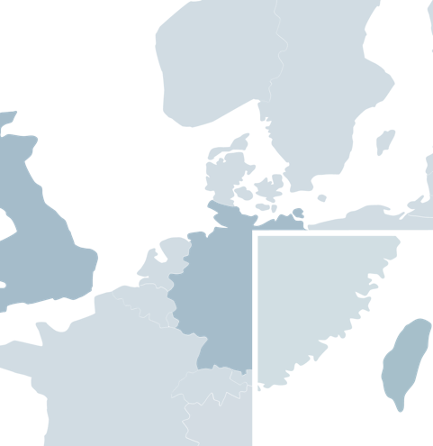
Bold Tern track record
No. | Site | Client | Turbine model | Year
30 | Zhong Neng | COP/CSBC-DEME | V174 9.5MW | 2024
29 | ChangFang Xidao | COP/CSBC-DEME | V174 9.5MW | 2024
26 | Greater Changua | Orsted | SG 8.0MW 167 | 2023
25 | Formosa 2 | SGRE | SG 8.0MW 167 | 2023
24 | Changfang Xidao | COP/CSBC-DEME | V174 9.5MW | 2023
16 | Formosa 2 | SGRE | SG 8.0MW 167 | 2022
15 | Changfang Xidao | COP/CSBC-DEME | V174 9.5MW | 2022
13 | Moray East | Vestas | V164-9.5MW | 2021
8 | Hornsea 1 | SGRE | SG 7.0 154 | 2019
5 | Borkum Riffgrund 2 | MHI Vestas | V164-8.0MW | 2018
2 | Galloper | SGRE | SG 6.0MW 154 | 2017
1 | Veja Mate | Siemens Gamesa | SG 6.0MW 154 | 2017
Europe
13
8
1
5
2
APAC
15
24
16
25
26
29
30

Slide 22
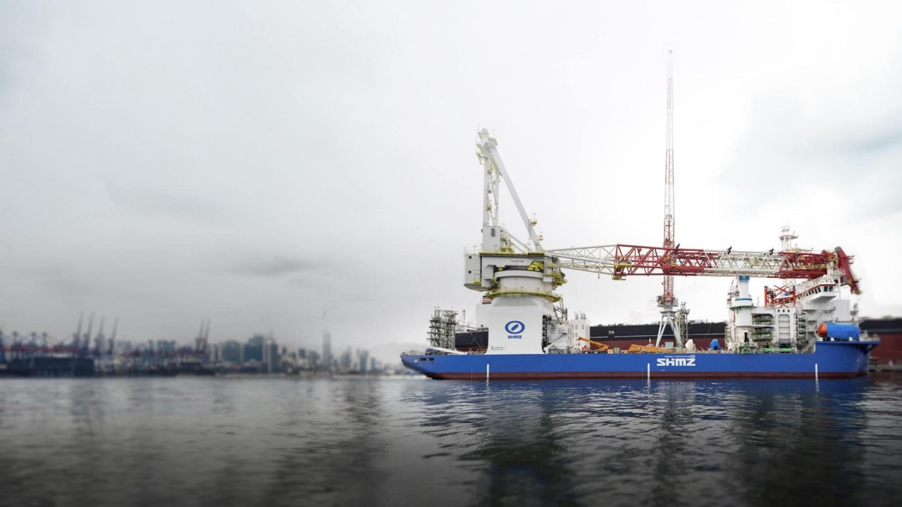
Blue Wind
A loading capacity that will streamline your installation process
10 - 50m
2,500t
10,000t
Of operation water depth range
Main crane
Max variable load

Slide 23
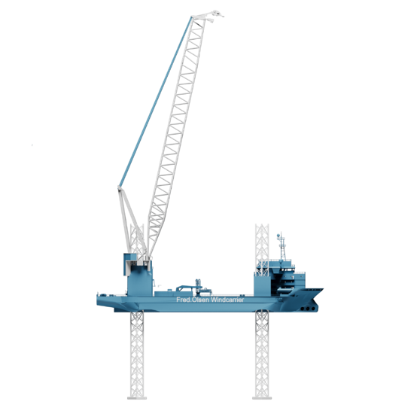
Blue Wind specs
Main Crane:
2,500t@30m
Cargo capacity:
Max variable load [t]: 10,000 (est.)
Available deck space [m²]: 4,600
Legs:
Number & type: 4 x 3 cord trussed legs
Length [m]: 109
Propulsion:
11 knot SPS-B
Hull breadth mid [m]: 50
Max leg length below baseline [m]: 50
Hull length [m]: 142

Slide 24
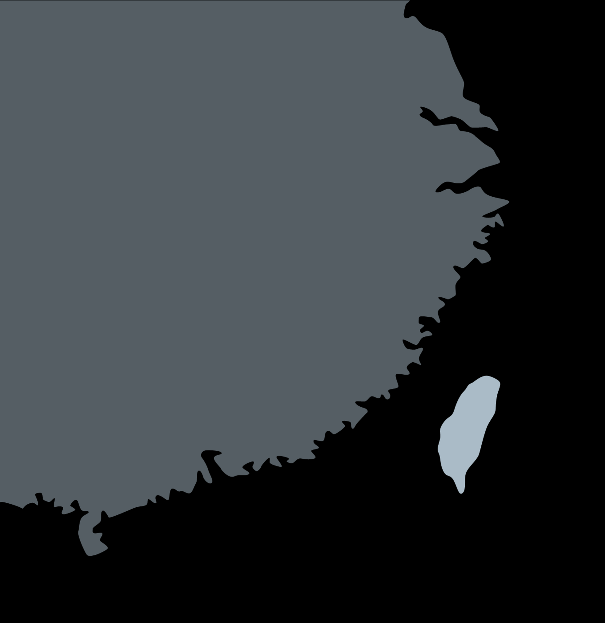
Blue Wind track record
No. | Site | Client | Turbine model | Year
1 | Greater Changhua | Orsted | SGRE 8.0-167 WTGs | 2024
2 | Yunlin Foundation | Skyborn | Foundation | 2024
3 | Greater Changhua | Orsted | SG 8.0MW 167 | 2023
APAC
2
1/3

Slide 25
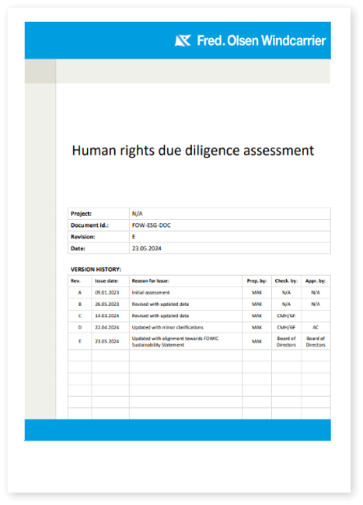


Sustainability is tied to everything we do
We are steps ahead
– making it easier for you
We proactively engage in reporting practices and adopt new regulatory requirements that go beyond what is required of us. We meet, and exceed, requirements that keep us steps ahead.
Trust us in all aspects of sustainability
We work, think, and care about sustainability in the broadest possible sense - both its environmental, social, and governance aspects.
Learn more about sustainability

Slide 26

Navigating into the future
Floating wind
Floating wind plays a crucial role in the global shift towards green energy. We therefor dedicate significant time to investigating how to develop the industry and make installation and maintenance of floating wind more efficient.
.
Watch floating wind

Slide 27




Our alliance concept
Increase Certainty
 | Alliance Partnership
Time Horizon: | Long term
Number of Suppliers: | Minimum suppliers
Risk Sharing & incentives: | Aligned incentives and shared upside / downside risk
Team Organization: | Integrated and empowered, "best person for the job"
Geography: | Co-location of teams
Documentation: | Minimum documentation
Improvement: | Common improvement language
Standardization: | Standard processes, interfaces and equipment
Transparency
Integration
Retention & development
Reduce Time
Reduce Complexity
Standardization
Optimizing performance
Continues improvement
Reduce Complexity
Increasing Safety
Cost reduction
Optimized logistics
Increase Sustainability
Future proof
Emission reduction
Ability to adapt

Slide 28
New Tern
Ready for next generations WTG´s
Extended width for larger project components
Maximized lifting heights
World Class Client space
More & larger client spaces for efficient on-board
project corporation
Greener Operations
Energy recovery
Minimized energy consumption
Maximization of shore power
Hybrid power setup
Clean exhaust and wastewater prior to discharge
More components per trip. Less trips. Less fuel.

Slide 29
Thank you

